Slide 1
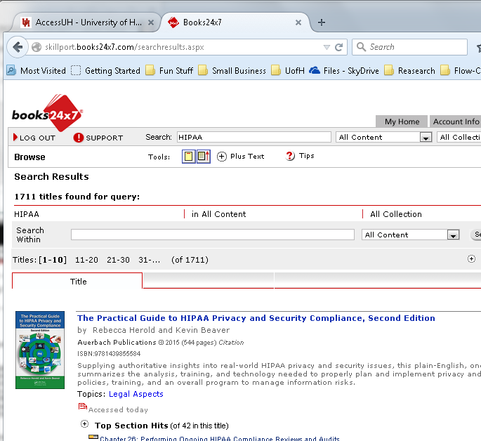
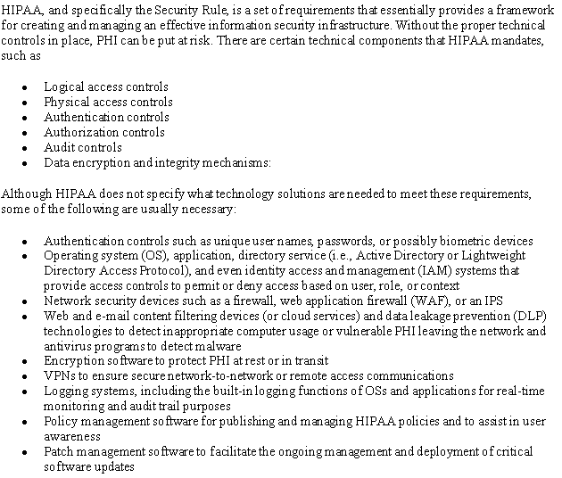

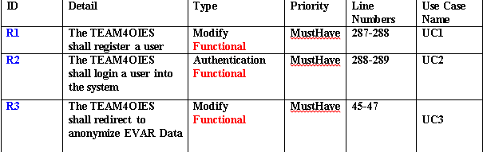
TEAM4OIES Online International EVAR System (ANONYMIZED Long Term Follow up EVAR Database)

